Slide 1
What is Colby’s Philosophy?
S
T
U
D
E
N
T
A
F
F
A
I
R
S
– I will prioritize the needs and full potential of stakeholders (ideally students) in my daily and continued work, and I will only commit myself to organizations that demonstrate community impact.
– I will continue to teach and learn from and with the field through knowledge communities, conference presentations, webinars, and additional professional development opportunities.
– I will seek to understand others before striving to be understood. I will acknowledge the value and unique perspectives of each individual and unit through active listening and learning
– As a graduate of the Clemson M.Ed. Counselor Education, Student Affairs program I will disrupt environments, policies, and thinking that are embedded with discrimination, microaggressions, and systemic oppression which hinder authenticity and the full potential of the collective population
– As a leader I will start from a place of empathy, recognizing that equitable change can only come from acts of community care. I will strive to create equitable, just, and caring environments for all members.
– I will be conscious of how I can nurture reflection and personal growth in myself, in others, and in the communities I support. I will surround myself with colleagues who will challenge and support me to grow.
– I will maintain to think with a critical lens about educational initiatives, programs, and services as well as their impact at each level.
– I will embrace the metaphor to act as a sponge soaking up and releasing knowledge with others, all while remembering to water the ground where I find myself.
– I will embrace a failing forward mentality and own my missteps and struggles as learning opportunities, and to not strive toward perfection.
– I will collaborate with others to foster exploration with grounded comfort in the uncertainty. As a member of the LeaderShape community, I will live in a state of possibility.
– I will strive to align my core values with organizational cultures, missions, visions, and goals. I will do the best job I possibly can serving others and working toward achieving excellence with the time and resources I can provide.
– I will be determined in bringing ideas to reality that ensure student success and support holistic student development.
– I will acknowledge and recognize the interconnected nature of our collective work, the higher education experience and individuals I work with.
– I will value sustainability and scalability as it pertains to creating work that is co-constructed and has positive impact beyond one-time usage (e.g., programs, systems, and internal training opportunities)
Notes:
With major life events and milestones happening in the coming years, I am often reminded of how my elders have shaped who I am today. I want to honor their love for crossword puzzles, caring for others and Jeopardy, as I sit with this answer . . . Well, question. What is your student affairs philosophy?
That’s a great question, and while I may not know exactly what my endgame is and how student affairs will be part of it, I know that this guiding philosophy that you see on the screen will be a mantra that stays with me throughout my personal and professional journey.
Throughout the graduate coursework and experiences over the past two years, I have been able to raise my consciousness and stretch my comfort in developing a guiding philosophy that is comprised of:

Slide 2
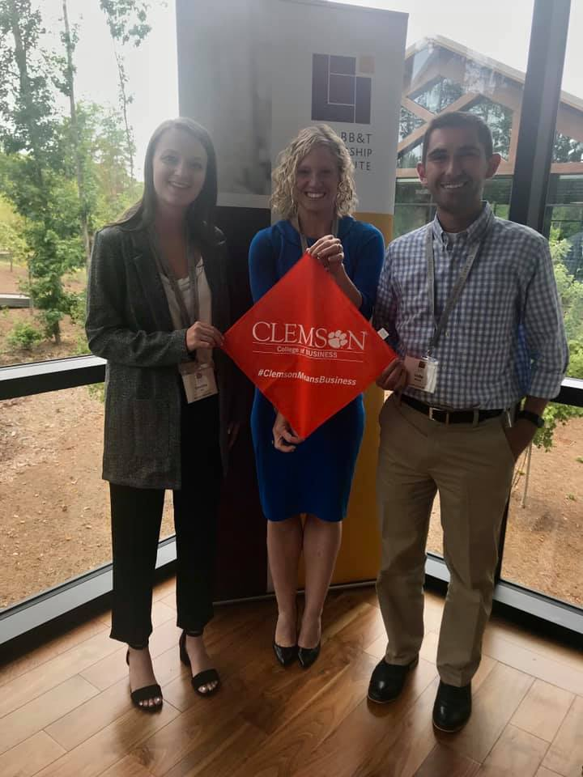
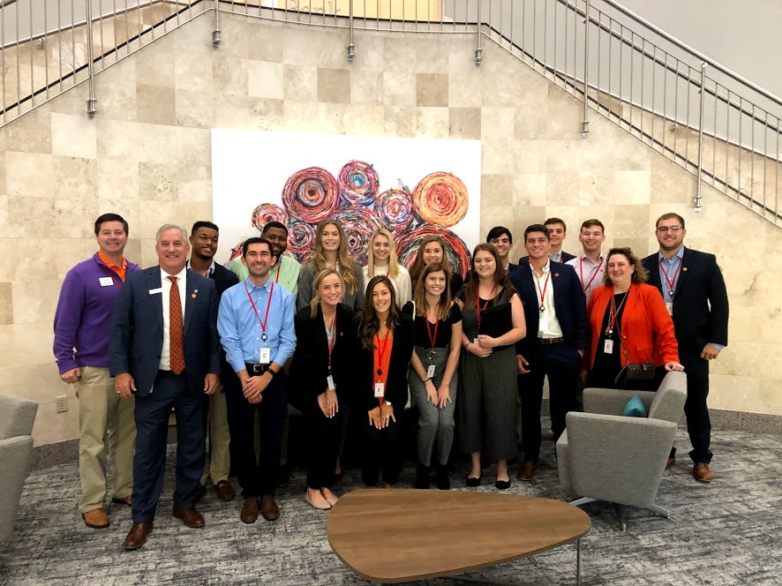
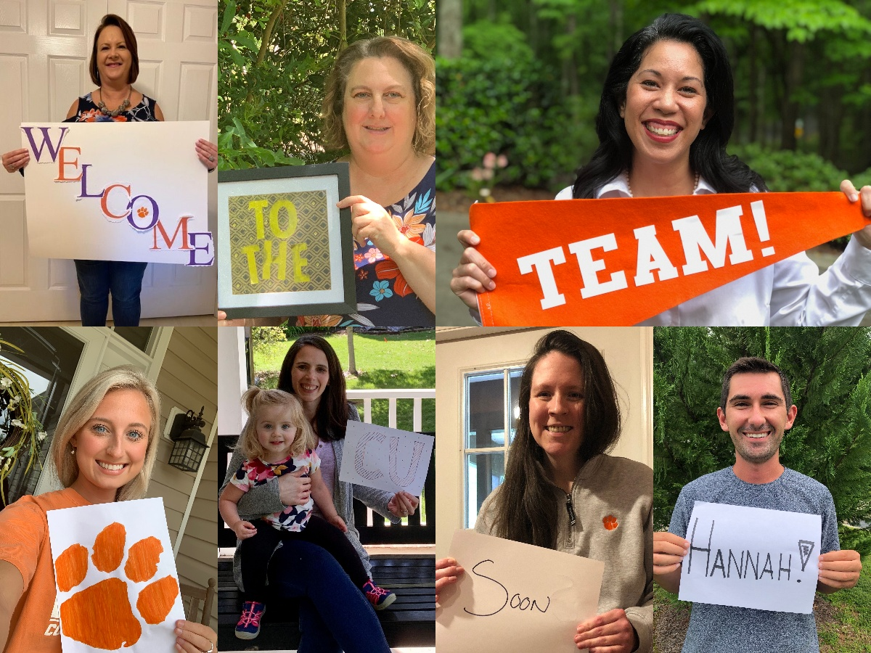
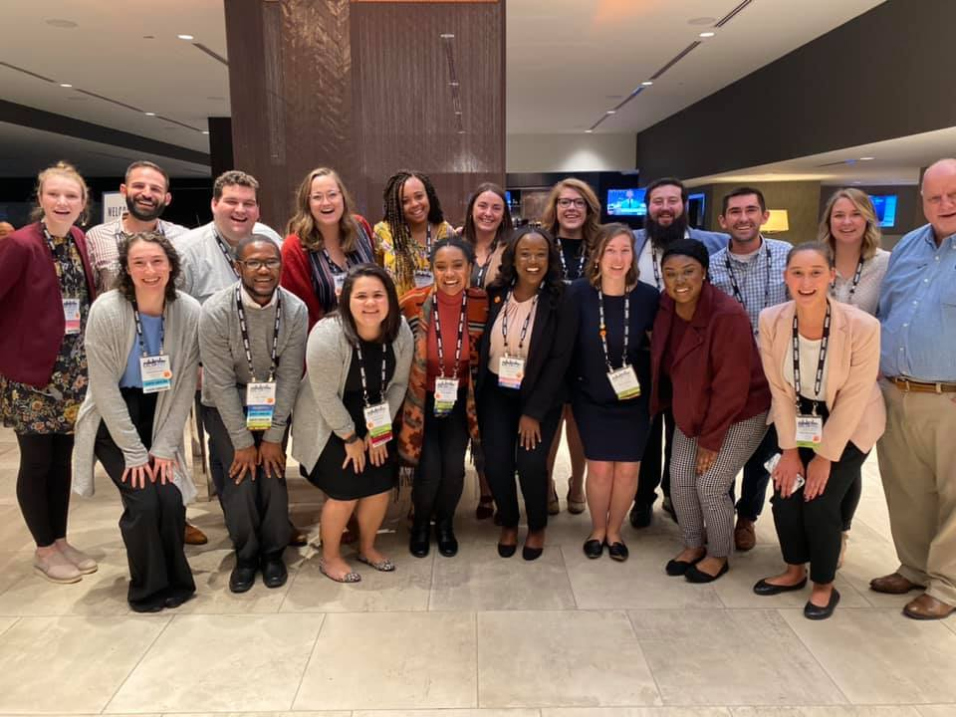
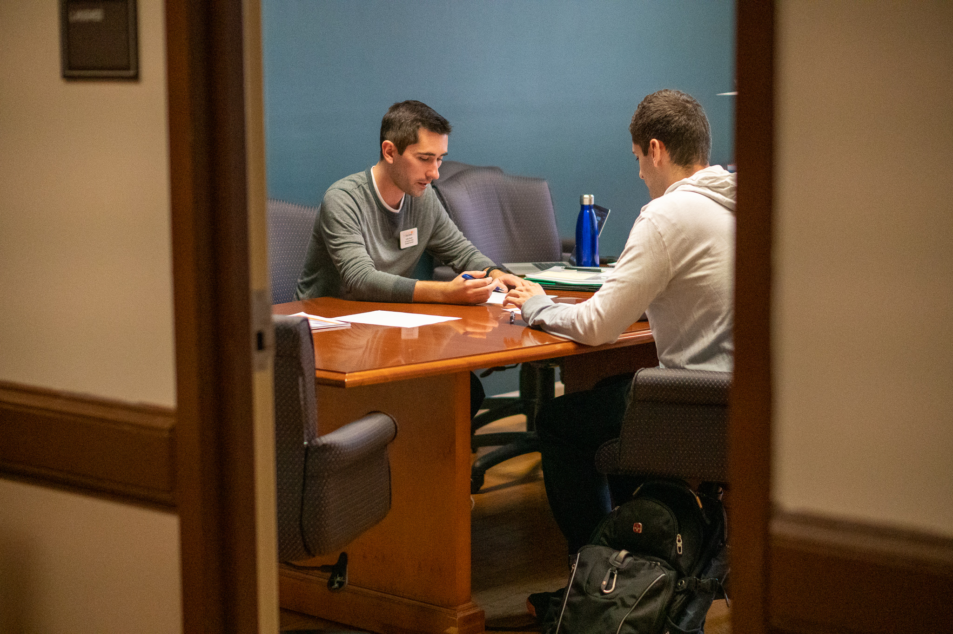
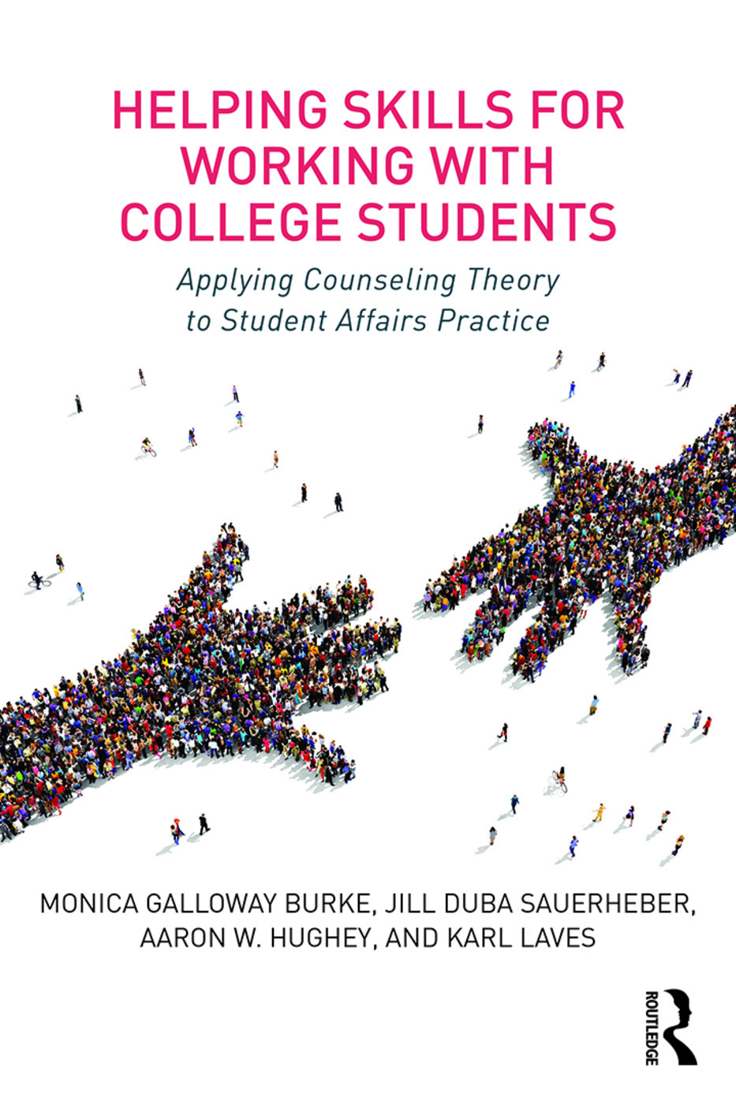
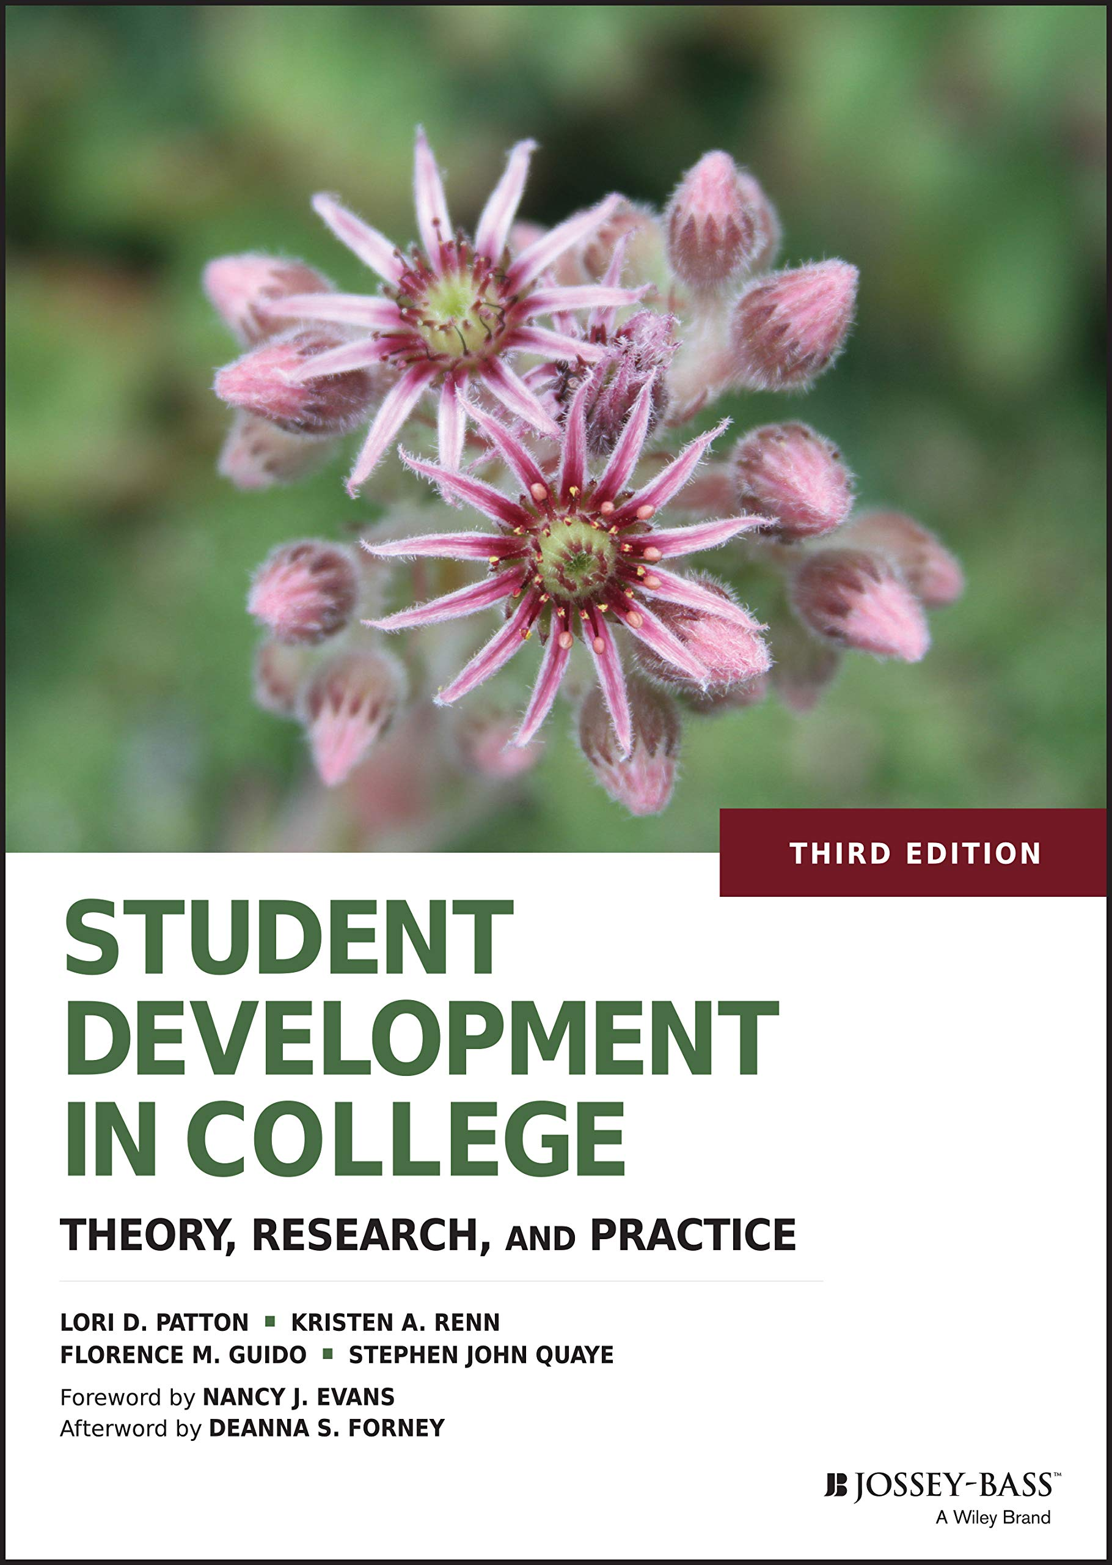
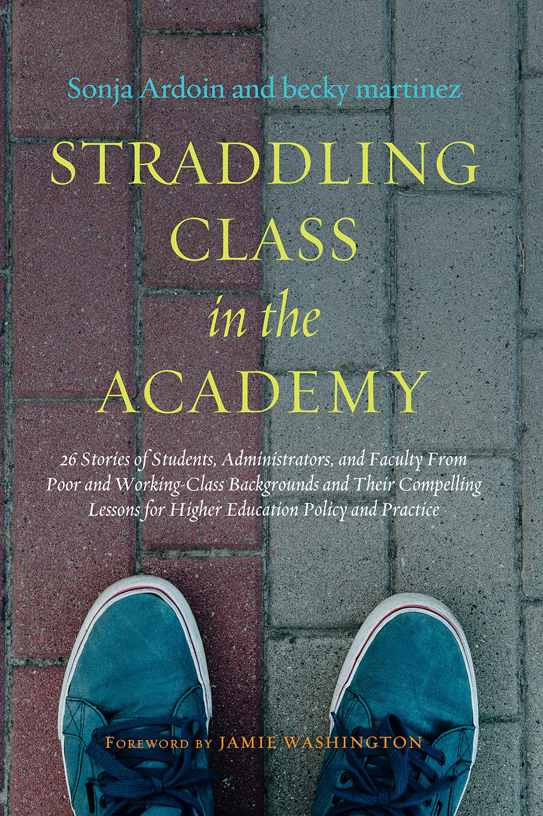
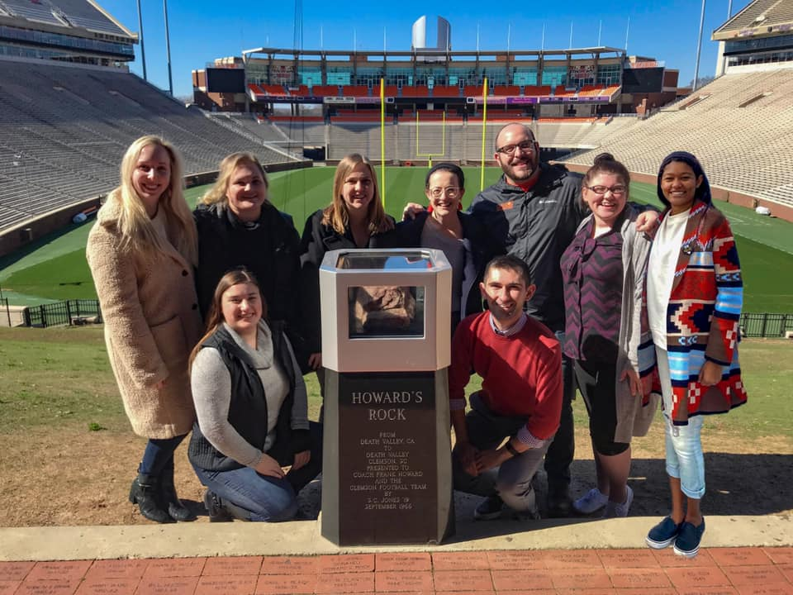
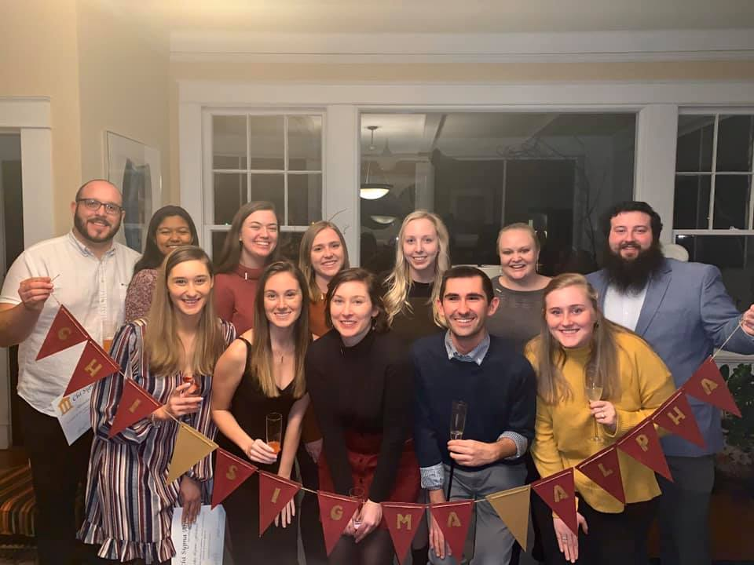
Culmination of 2(6) years
1:1 Supervision
First Citizens + Networking Trek
BB&T – North Carolina
SACSA – North Carolina
Team Bonding + Transitions Subcommittee
Review Sessions
Professional Memberships
Campus Involvement
Field Experiences
SPA
Chi Sigma Alpha
Notes:
Through the process of curiosity, reflection, and self-authorship, I was able to operate within a new environment – one that is small, but mighty serving as central student affairs unit within an academic setting where academic and career excellence competes with holistic student development and wellness.
Without any intentional onboarding nor former CU Business EDGE Graduate Assistant – as this was the first iteration of this role – my student affairs philosophy continuously adapted and was refined as we built the plane as we flew it. There was a lot of learning with academic and student affairs professionals at Clemson, in the state and within the region at then BB&T External Facilitator Training. I had the chance to model, mentor, and facilitate growth and reflection during a banking and networking trek to Raleigh, North Carolina in Fall 2020.
The program further cultivated myself being an active practitioner who engages in service and professional development at each level by serving on CU-GARS committees, getting involved with SPA and Chi Sigma Alpha, designing documents for SCCPA, and representing Clemson at SACSA and ACPA.
Lot of memories, LeaderShape reunions, and connections to our courses, I continuously brought theory to practice – whether it was in conversations with students and hearing cognitive distortions in what they were sharing or working to disrupt how our office previously programmed.
Through Advising and Supporting as well as Student Development Theories, I am confident in building rapport, co-constructing goals and providing the space for students to lead from their own agency.
This internal voice of care, however, didn’t stay internal. Despite being in a student affairs type office within a competitive academic environment that doesn’t always prioritize wellness, it was evident that leading without positional authority would be a challenge. In fact, within the first month an individual with high authority power joked that all I would do is ask students to sit around a campfire and sing koom bay yah. . . Not a great environment to feel welcomed nor valued.
Thankfully, through field experiences and supporters outside of the college who do value what this program and what higher education can do, I began to bring visions to reality and foster application and leadership development within and among others, which in turn led to steadfast decision-making that would create just and equitable experiences and environments.

